Slide 1
Kantar Media: DevOps Tools and Recommendations
2018

Slide 2
DevOps Pipeline
Release Management
Collaboration/ KM Management
Code Checkout
Code Construction
Unit Testing
Code Review
Code Conflict Management
Version Management
Build
Functional Testing
Deployment – QA/SIT/UAT
Package and Artifact Mngt.
Tag Release
Static/Dynamic Code Analysis
Integration Testing
Security Testing
Performance Testing
User Acceptance Testing
Service Management
Release to
Production
Monitoring
Requirement Management
Technologies
React / Angular
Azure PaaS
Azure Functions
ELK
Manual Task
Release and Change Management
Tool driven
Not Present
Out of Scope
Test Case/Data Management

Slide 3
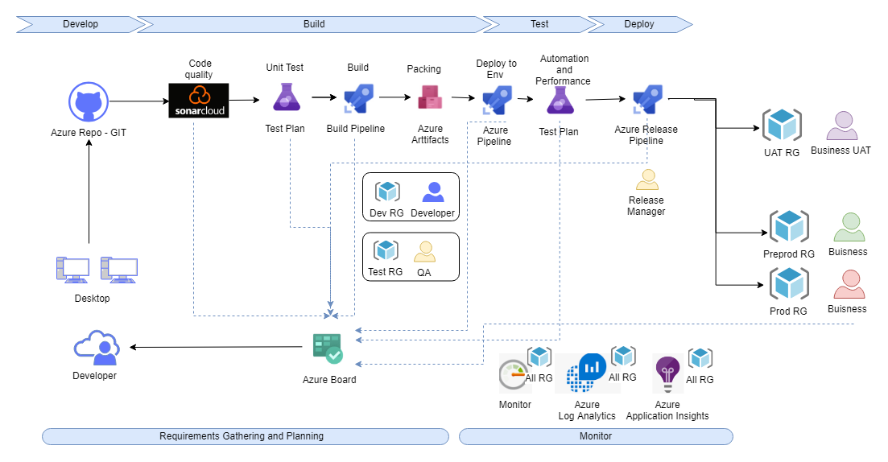
High Level CI-CD Model

Slide 4
Tool stack Recommendation
SDLC Phase | DevOps Function | Description | Recommended tools (AZS)
Requirement Analysis and Planning | Requirement Management | Version control of requirement documents, Role based access to Document Libraries | Azure Board
 | Change Assessment | Requirement Change Management | Azure Board
 | Metrics Management &Reporting | Automated Impact Analysis and reporting through full life-cycle traceability, Real-time Business Readiness Dashboard | Azure Board Azure Application Insights Azure Log Analytics Azure Monitor
 | Knowledge Management | To have all the project documents and communicate, collect and manage information | Azure Wiki
 | Application Life cycle Management | ALM covers the entire lifecycle from the idea conception, through to the development, testing, deployment, support and ultimately retirement of systems | Azure Board
Design Development & Source Control | Build Tool | Conversion of code into binary | Azure Build Pipeline
 | Code Analysis | Automated Static Code Analysis, for correctness, security, and performance considerations | Sonar Cloud [ Azure Marketplace]
 | Source Control | Version control of Source Code | Azure Repos
 | Code Coverage | measure of Degree to which the source code of a program is executed when a particular test suite runs | Sonar Cloud [ Azure Marketplace]
 | Unit testing | Testing the smallest part of applications | Azure Test Plans
 | Test Automation | Test Automation Framework(s) to support Behavior Driven Development | Azure Test Plans
Continuous Integration | Continuous Build, Integration and Deployment | Continuous Integration & Automated Build Deployment Process, Installation Testing | Azure Build Pipeline Azure Library Azure Deployment Group
Environment and Release management | Environment Provisioning | Automated Environment Provisioning, Automated Virtualized Service Deployment, Monitoring | Azure Resource Manager
 | Deployment Management | Automated code deployment | Azure Build Pipeline Azure Library Azure Test Plans Azure Deployment Group
 | Monitoring | Monitoring of Applications and Infrastructure | Azure Application Insights Azure Log Analytics Azure Monitor
 | Release Automation | Automating the process of packaging and deploying an application or update of an application from development, across various environments, and ultimately to production, including approvals | Azure Release Pipeline
 | Artifactory Management | Release artifact maintenance and versioning for effective release management and rollback | Azure Artifacts
 | Team collaboration | Collaboration and coordination between Development , Testing, and project Management team | Microsoft teams

Slide 5
Zero Downtime Release Strategies
Type of Deployment | Description | Advantage | Disadvantage
Blue/Green Deployment | In the Blue/Green deployment pattern, a load balancer directs traffic to the active (Blue) environment while you upgrade the standby (Green) environment. After smoke testing the application in the Green environment and establishing that it is operating correctly, you adjust the load balancer to direct traffic from the Blue environment to the Green environment. | The Blue/Green deployment pattern provides a safe way to upgrade applications without interrupting their use. Blue/Green deployments work particularly well for monolithic applications that can take significant time to deploy, because you have full control over the point at which users can access the new version of the software. | Adopting the Blue/Green deployment pattern can increase operational overhead because you have to maintain duplicate Production environments with identical infrastructure. Additionally, updating database schemas while following a Blue/Green approach requires caution, as the new version of the application cannot use the database until it has been upgraded.
Rolling Updates | In a rolling update, each server node in the environment is taken offline and upgraded, one by one. After a node is upgraded, manual or automatic smoke testing determines whether the application is functioning as expected. If the application is up and running properly, its server node is made available for user traffic, and the next node is taken offline to be upgraded. | A rolling update is an incremental way of achieving zero-downtime deployments. Rolling updates work well for deployments that you expect to execute quickly, so you can minimize the impact on users. | While a rolling update is executing, the environment will be somewhat unpredictable because different versions of the application are running in it at the same time. Also, the application architecture must support running in cluster mode because multiple instances of the application will access the database during the update. Finally, taking servers offline means that there is less capacity for user traffic during the update.
Canary Releases | In a canary release, you upgrade an application on a subset of the infrastructure and allow a limited set of users to access the new version. This approach allows you to test the new software under a Production-like load, evaluate how well it meets users’ needs, and assess whether new features are profitable. A canary release is similar to a rolling update because it involves releasing a new feature in a staged manner. However, when you perform a rolling update, you only verify that the application is technically stable and functional before moving on to the next stage of the rollout. With a canary release, you evaluate users’ reactions to a new feature or functionality before deciding whether to release it more widely. | Canary releases are a good way to release experimental or beta features to users and gather their feedback. For example, you can use a canary release to roll out a new feature to users in a specific geographic region. If those users like the feature, you can deploy a canary to another region and test the user response there; or, you could choose to upgrade all remaining nodes in the environment, possibly by applying another release pattern to minimize application downtime. | Canary releases pose similar risks to rolling updates because multiple versions of the same application run in the environment while the canary release is deployed. For that reason, the environment will be somewhat unpredictable during the canary timeframe, and the application architecture must support running in cluster mode so that multiple instances can access the database

Slide 6
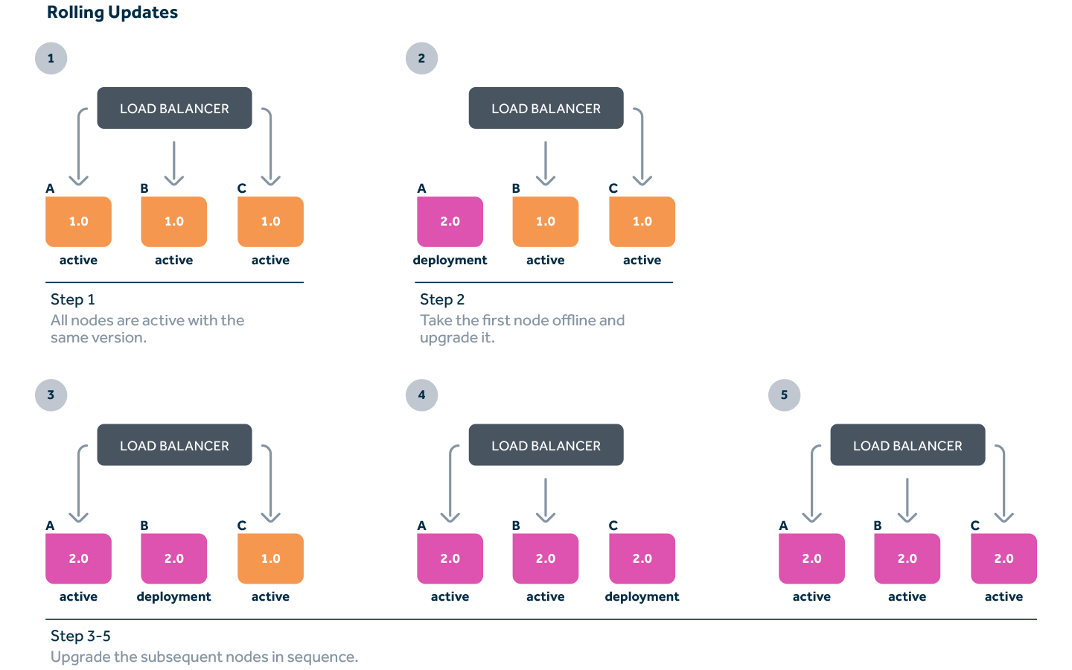
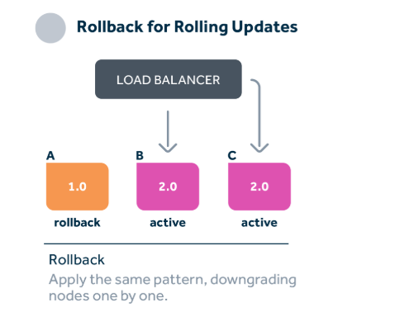
Release Pattern Recommendation
Release Pattern
Rollback Pattern
Ref : https://docs.microsoft.com/en-us/azure/sql-database/sql-database-manage-application-rolling-upgrade
Ref: https://blog.xebialabs.com/2018/10/30/take-release-automation-to-the-next-level-episode-3-rock-your-pipeline-with-rolling-updates/

Slide 7
Tool level access
Role | Azure Repo |  |  | Azure Boards |  |  | Azure Test Plans |  |  | Azure Dashboards
 | View | Edit | Delete | View | Edit | Delete | View | Edit | Delete | View | Edit | Delete
Developer | Yes | Yes | Yes | Yes | Yes | Yes | Yes |  |  | Yes
Tester | Yes | Yes | Yes | Yes | Yes | Yes | Yes | Yes | Yes | Yes
Managers |  |  |  | Yes | Yes | Yes | Yes |  |  | Yes | Yes | Yes
DevOps engineer | Yes | Yes | Yes | Yes | Yes | Yes | Yes |  |  | Yes | Yes | Yes
Business Analyst |  |  |  | Yes | Yes | Yes |  |  |  | Yes
IT Support |  |  |  | Yes | Yes | Yes |  |  |  | Yes
Release Manager |  |  |  | Yes | Yes | Yes |  |  |  | Yes
Administrator | Yes | Yes | Yes | Yes | Yes | Yes | Yes | Yes | Yes | Yes | Yes | Yes
Customers |  |  |  | Yes | Yes | Yes |  |  |  | Yes

Slide 8
Tool level access (Cont..)
Role | Azure Pipelines |  |  | Azure Wiki |  |  | Azure Artifacts
 | View | Edit | Delete | View | Edit | Delete | View | Edit | Delete
Developer | Yes | Yes | Yes | Yes | Yes | Yes | Yes | Yes | Yes
Tester |  |  |  | Yes | Yes | Yes
Managers |  |  |  | Yes | Yes | Yes
DevOps Engineer | Yes | Yes | Yes | Yes | Yes | Yes | Yes | Yes | Yes
Business Analyst |  |  |  | Yes | Yes | Yes
IT Support |  |  |  | Yes | Yes | Yes
Release Manager | Yes | Yes | Yes | Yes | Yes | Yes | Yes | Yes | Yes
Administrator | Yes | Yes | Yes | Yes | Yes | Yes | Yes | Yes | Yes
Customers |  |  |  | Yes | Yes | Yes

Slide 9
Environment level access
Role | Dev | QA | UAT | Pre Prod | Prod
Developer | Yes | Yes ⁺
Tester | Yes ⁺ | Yes
Managers | Yes | Yes* | Yes*
DevOps Engineer | Yes | Yes | Yes
BA | Yes | Yes | Yes |  | Yes'
IT Support |  |  | Yes ⁺ | Yes | Yes
Release Manager |  | Yes | Yes | Yes | Yes'
Customers |  |  | Yes^ | Yes | Yes
* Test managers
^ Business / UAT testers
‘ Restricted prod access
+ Conditional access

Slide 10
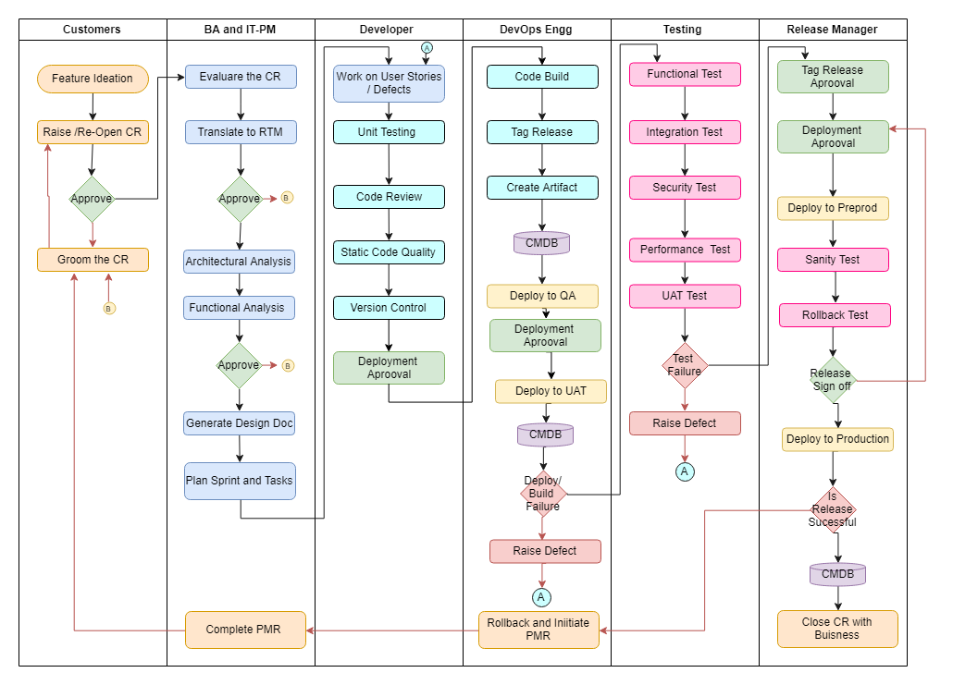
DevOps Workflow
DevOps is the blending of the terms development and operations, meant to represent a collaborative or shared approach to the tasks performed by a company's application development and IT operations teams.
DevOps is an operational philosophy that promotes better communication between these teams -- and others. In its most narrow interpretation, DevOps describes the adoption of automation and programmable software development and infrastructure deployment and maintenance.
The term may also label a culture that strategically looks at the entire software delivery chain, overseeing shared services and promoting the use of new development tools and best practices.
This picture shows a devops , that will be inline with IITL standards that Kantar Media can use.
CMDB will hold the AES, PaaS, Third Party and in-house version and properties along with the major version of the software SQLDB is recommended service.

Slide 11
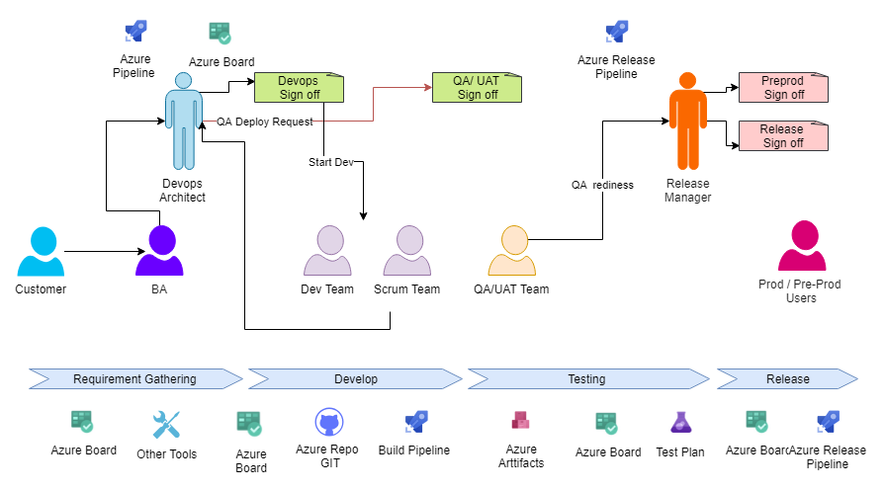
DevOps Governance Model
Dev and QA governance
Code in all controlled environment is governed by Devops Architect [DA], Facilitates new app and infra architecture changes.
Developers should follow organization standards to get code pushed into QA and get sign off from DA
QA is completely controlled environment, managed by DA.
UAT and Prod governance
Code in all business like environment is governed by Release Manager [RM], RM liaises between product owners, IT and Ops
RM acts as a gatekeeper to mitigate risk from change
RM ensures all signoffs and artifacts are in place and makes GO/NO-GO calls for releases
Ref: https://docs.microsoft.com/en-us/azure/devops/pipelines/release/approvals/?view=vsts

Slide 12
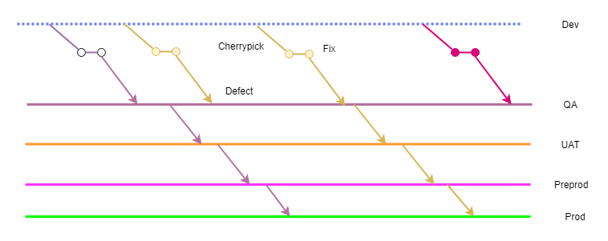
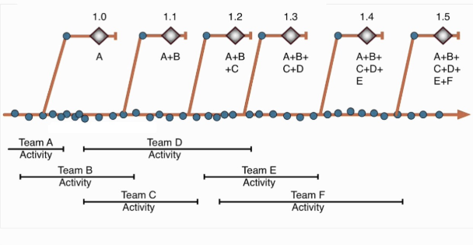
Branching Strategy - Trunk based development
Trunk based development and environment based branch
Each micro services will have trunks and the code will be deployed independently
Each development has trunk and they work on it
No code freeze
No merge issues or conflict
Bug fixes are done on each trunk
Each micro service will have its own trunk
Always the code is deploy ready
Each Environment has its distinct line in which they can maintain the integrity of the code
Environments will be synced to prod copy post releases
The defect is found after release. Indeed, the trunk (which had no code-freeze whatsoever) has already moved past release. The service which is bugged does not want to release a new version of the product with the latest commits on trunk, so it has to release something from the pre-existing release branch by cherry-picking fixing and releasing to production from the trunk
Ref https://paulhammant.com/2014/09/29/shades-of-trunk-based-development/

Slide 13
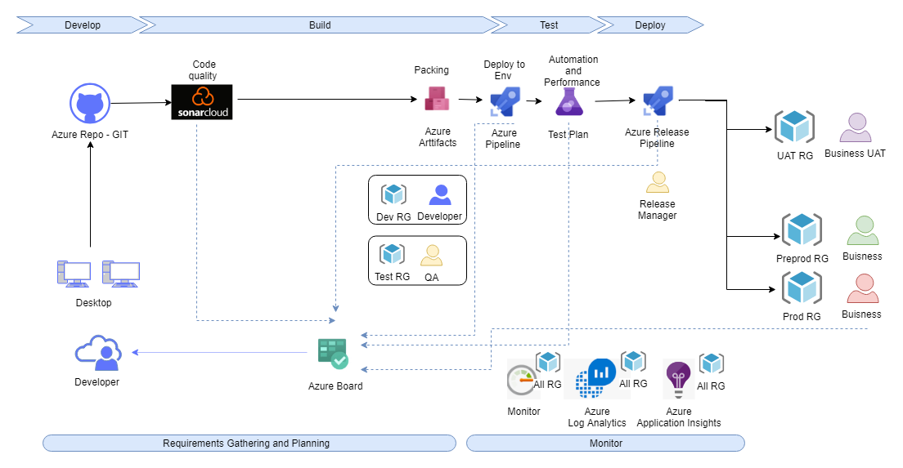
Server less Deployments

Slide 14
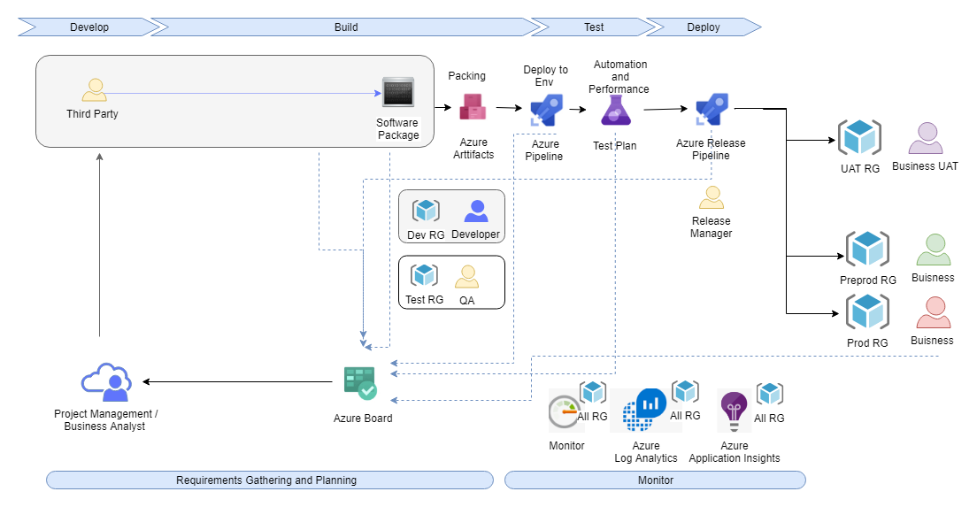
Third Party Software Deployments

Slide 15
Thank you

Slide 16
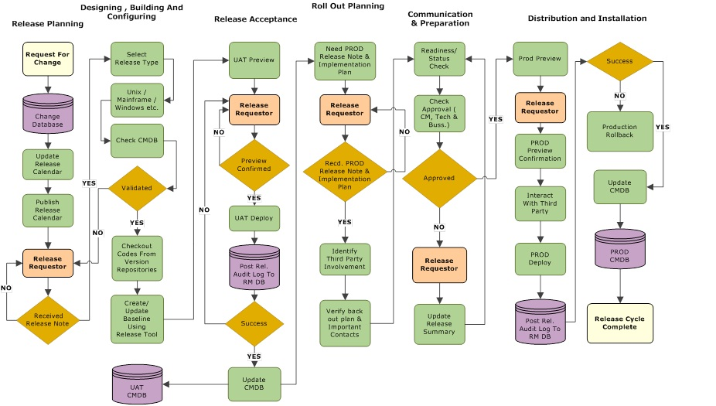
Appendix : Standard ITIL Release Workflow
Release Management is the process of managing, planning, scheduling and controlling a software build through different stages and environments; including testing and deploying software releases.
This picture shows a standard workflow, that will be inline with IITL standards that Kantar Media can use.

